Slide 1
IBM University Engagement Project Submission
“Exploring the Power of Agentic AI with IBM Granite and LangFlow”

Slide 2

Project Tile – Maternal Health SDG : An AI‑Powered Monitoring & Advisory System
Domain of Project – Healthcare / Public Policy
Student Name | Recent Passport Photo | Email ID | Mobile number [WhatsApp]
Asmita Pokharkar |  | pokharkarasmita42@gmail.com | 9326063091

Slide 3
Problem Statement -
Problem Statement : Tracking Maternal Health Progress Toward SDG
The Challenge :
Monitoring maternal health is critical to achieving SDG 3.1 (reduce global maternal mortality ratio to less than 70 per 100,000 live births by 2030). However, maternal health data is scattered across multiple government reports, surveys (NFHS, SRS), and policy documents. Policymakers and researchers lack a unified, intelligent system to analyse trends, predict future MMR, classify risk districts, and answer natural language queries about maternal health indicators. Without real‑time, evidence‑based insights, resource allocation and policy interventions remain suboptimal.
The Objective :
Build an AI‑powered Maternal Health Agent that:
Analyses historical MMR data (from AIKosh SDG dataset) using machine learning.
Predicts future MMR (regression) and classifies risk levels (High/Medium/Low).
Forecasts progress to 2030 (time‑series) to identify states/countries on track to meet SDG 3.1.
Provides a RAG‑based Q&A assistant (IBM Granite) that answers queries like “What is the biggest driver of MMR reduction in India?”
Visualises insights via an interactive dashboard (Streamlit / Power BI) for policymakers and researchers.

Slide 4
Technology Used :
I have used LangFlow + IBM watsonx.ai + Granite Models :
LangFlow – Orchestrate RAG workflow and agent interactions.
IBM watsonx.ai – Deploy Granite model, embeddings, and governance.
IBM Granite (granite‑3‑2‑8b‑instruct) – Natural language reasoning for Q&A.
Google Colab – Data preprocessing, ML model training (Random Forest, XGBoost, Linear Regression).
FAISS / Chroma – Vector database for RAG retrieval (nutritional/fact sheets).
Streamlit – Interactive dashboard for visualisations and user queries.

Slide 5
Proposed Solution -
The proposed solution is a multi‑agent AI system built using LangFlow, IBM watsonx.ai, and Granite models to monitor, predict, and advise on maternal health progress.
Core components:
1. ML Pipeline (Google Colab)
Loads AIKosh SDG dataset and filters maternal indicators (MMR, skilled birth attendance, antenatal care, adolescent birth rate, health worker density).
Trains Random Forest & XGBoost regression models to predict MMR from health indicators.
Trains Random Forest classifier to label districts/states as Low (<70), Medium (70–139), or High (≥140) risk.
Performs linear trend forecasting to project MMR up to 2030.
2. RAG‑based Q&A Assistant (IBM Granite + LangFlow)
Uses a vector store built from the AIKosh dataset and additional policy reports.
Answers natural language questions: “Which Indian state has the highest MMR?”, “Is India on track to meet SDG 3.1?”, “What factors most affect MMR?”.
Granite model provides grounded, context‑aware answers.
3. Interactive Dashboard (Streamlit)
Visualises historical MMR trends, state‑wise risk maps, forecast to 2030, and feature importance.
Embeds the RAG chat interface for live queries.
This end‑to‑end solution empowers policymakers, researchers, and health workers with data‑driven insights to accelerate progress toward SDG

Slide 6
Langflow component Used -
Chat Input | User asks questions about maternal health (e.g., "What is the MMR trend in India?")
IBM watsonx AI Agent | Processes user query using Granite model to generate answers based on retrieved context
IBM Granite Model | ibm/granite-3-2-8b-instruct – Fast, accurate reasoning for health‑related Q&A
Chat Output | Displays AI‑generated answers, including statistics and policy recommendations
File Component | Loads AIKosh CSV dataset and pre‑computed ML model outputs (predictions, forecasts)
Vector Store (FAISS) | Stores embeddings of dataset rows and policy documents for RAG retrieval
Text Splitter | Chunks long documents (e.g., SDG reports) for efficient embedding

Slide 7
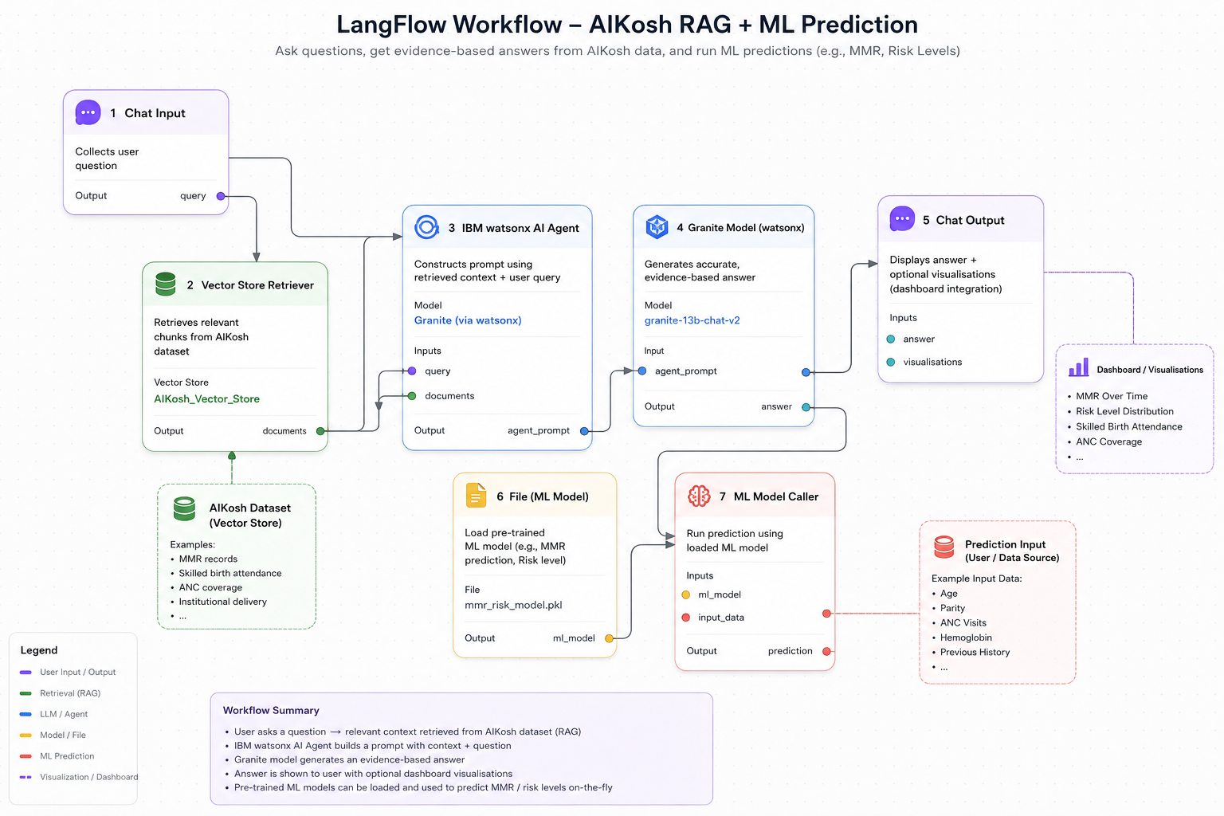
Langflow / Architecture workflow -

Slide 8

Role of Agentic AI in the solution
Agentic AI enables the Maternal Health Agent to act as an autonomous, intelligent advisor rather than a static dashboard.
Using IBM watsonx.ai and IBM Granite, the system coordinates multiple specialised capabilities:
Data Analysis Agent – Runs ML models to predict MMR and risk categories.
Forecast Agent – Projects future MMR trends using time‑series models.
RAG Q&A Agent – Retrieves relevant policy data and answers natural language queries.
Visualisation Agent – Generates charts and maps on demand.
These agents collaborate and communicate, providing context‑aware, real‑time insights. The system adapts when new data (e.g., latest NFHS survey) is added, re‑training models and updating the vector store.
Overall, Agentic AI makes the solution proactive, goal‑driven, and intelligent – acting like a virtual public health analyst that helps India and other countries track and achieve SDG

Slide 9
Technology Used :
LangFlow | Visual orchestration of multi‑agent workflows and RAG pipelines
IBM Granite (ibm/granite-3-2-8b-instruct) | Natural language understanding, reasoning, and answer generation
IBM Cloud | Secure, scalable deployment of the complete agent system
IBM watsonx.ai | Model hosting, embedding generation, and AI governance
Google Colab | ML model training (Random Forest, XGBoost, Linear Regression)
FAISS / Chroma | Vector database for RAG retrieval
Streamlit | Interactive dashboard for data visualisation and chat interface
Python (pandas, scikit‑learn, xgboost, joblib) | Data processing and ML model development

Slide 10
Novelty and Uniqueness
The proposed Maternal Health SDG Tracker offers several unique advantages:
Multi‑Agent Intelligence – Combines ML prediction, time‑series forecasting, and RAG‑based Q&A into a single cohesive system.
RAG‑Based Accuracy – Answers are grounded in official SDG datasets (AIKosh) and policy documents, reducing hallucination.
Predictive & Prescriptive Analytics – Not only forecasts MMR but also suggests interventions based on feature importance (e.g., “increase skilled birth attendance”).
Real‑Time Adaptability – New data (e.g., latest SRS bulletin) can be added to the vector store and ML retraining pipeline.
Policy‑Focused Visualisation – Interactive maps and trend lines designed for decision‑makers.
Scalable & Compliant – Built on IBM watsonx.ai with full governance, suitable for government use.
This goes far beyond a simple dashboard – it is an intelligent, autonomous maternal health advisor that helps nations achieve SDG

Slide 11
Git Hub Link : https://github.com/AsmitaPokharkar/Maternal-Health-SDG-An-AI-Powered-Monitoring-Advisory-System.git

Slide 12
Future Scope :
State / District‑Level Data Integration – Extend the current India‑level model to state‑wise and district‑wise analysis using granular NFHS and HMIS data.
Real‑Time Data Streaming – Integrate with health information systems (e.g., Health Management Information System) to update predictions dynamically.
Causal Inference & Intervention Planning – Use causal ML (e.g., double ML) to estimate the impact of specific policies (e.g., Janani Suraksha Yojana) on MMR.
Multilingual Support – Enable queries in Hindi, Tamil, Marathi etc., using IBM Granite’s multilingual capabilities.
Mobile App & WhatsApp Bot – Deploy the Q&A assistant on popular messaging platforms to reach grassroots health workers.
Integration with IBM Cloud Pak for Data – For enterprise‑grade governance and collaboration across multiple states.

Slide 13


